Slide 1
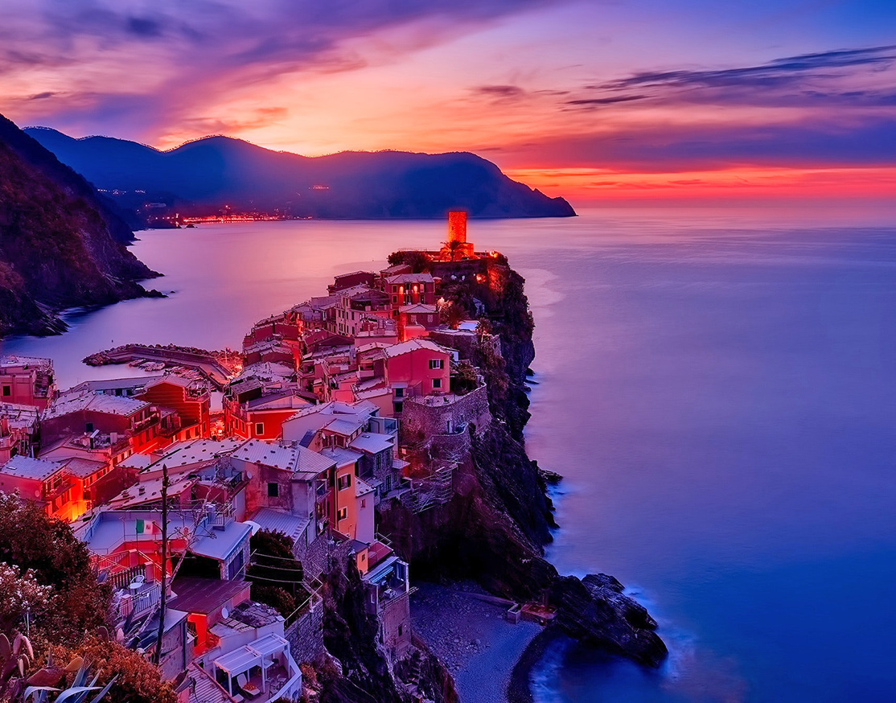
TravelMore
One stop to start your adventure
James G, Juwan R, Jamal R, Karamo D

Slide 2
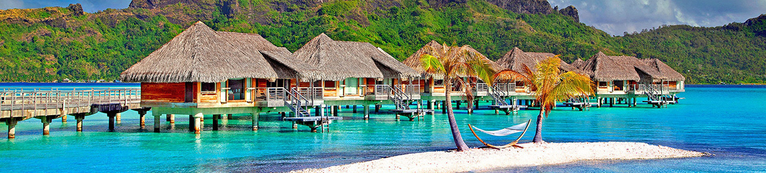
Developers
Developer Introduction

Slide 3
Tools and Technologies Used
Cutting edge tools used to build the website with the best user experence
FrontEnd
Backend and Middleware
Bootstrap
CSS
Html
JavaScript
API – Microsoft API
RDB – SQL server (Azure host)
MVC – Microsoft MVC
Language C# (.net)

Slide 4
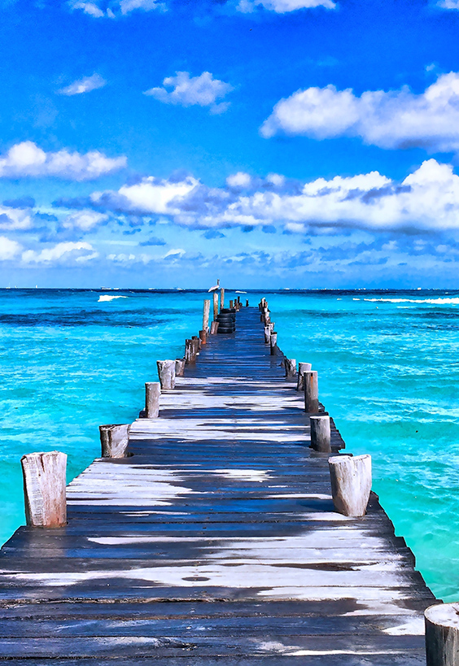
Why TravelMore?
A good display of Visual and Technical skill
Font awesome, Swiper, bootstrap
Excellent user experience
Easy to navigate to different sections, excellent data presentation
Quick response times
Streamlined features enable quick response times
Easily Expandable

Slide 5

Features and Components
Features of our Website, and what each section does
Homepage
User login/registration
User page
Hotel booking
Flight booking
Rental car booking

Slide 6

Future Plans
Additional Features
Auto Scrolling Swiper
More user interaction
Bug fixes
Algorithm implementation for scalability

Slide 7
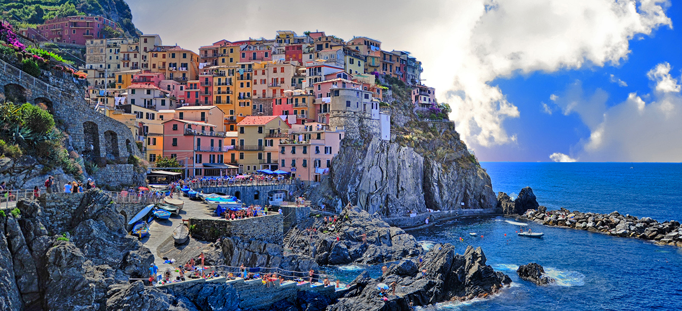
Questions?

